Slide 1
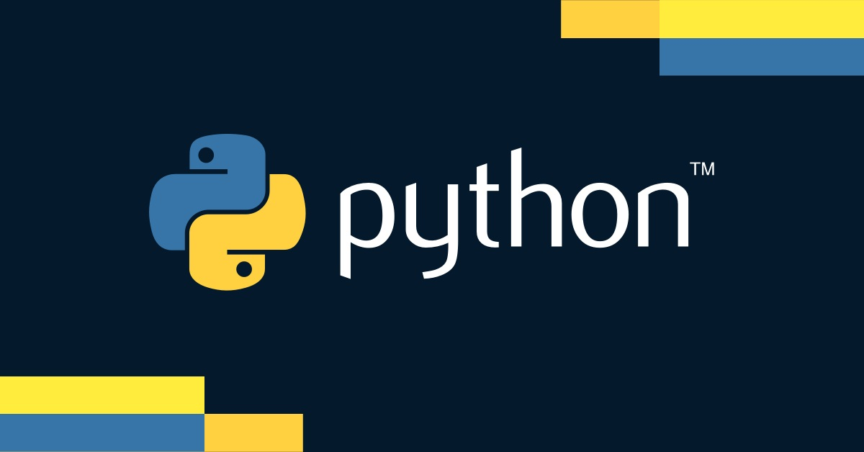

Slide 2
Introduction to RESTful APIs with Django

Slide 3
What is a RESTful API?
Definition
An architectural style for designing networked applications
Use HTTP requests to perform CRUD operations: Create, Read, Update, and Delete
Principles
Stateless
Each request from a client to a server must contain all the information needed to
understand and process the request
Client-Server Architecture
Separation of concerns between the client and server
Cacheable
Responses must define themselves as cacheable or not
Uniform Interface
Simplifies and decouples the architecture, allowing each part
to evolve independently
Layered System
The client does not need to know whether it is connected directly
to the end server or through an intermediary

Slide 4
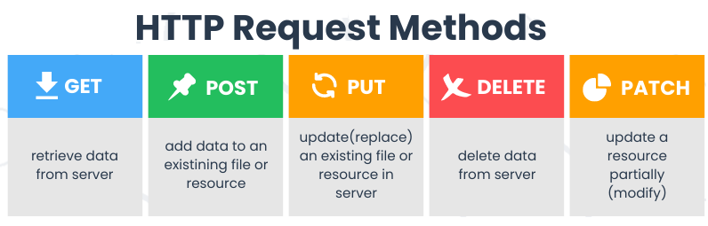
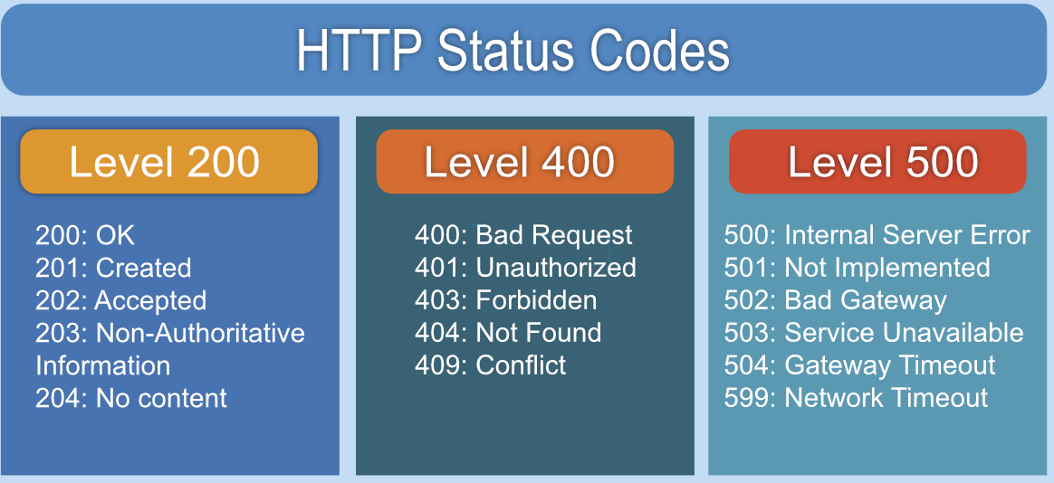
RESTful API Components
Resources
An architectural style for designing networked applications
Use HTTP requests to perform CRUD operations: Create, Read, Update, and Delete

Slide 5
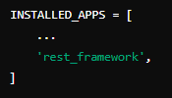
Introduction to Django REST Framework (DRF)
Introduction
DRF is a powerful and flexible toolkit for building Web APIs in Django
Provides features such as serialization, authentication, and view classes
Installation
Install DRF using pip
pip install djangorestframework
Add 'rest_framework' to INSTALLED_APPS in settings.py
Configuration
Example

Slide 6
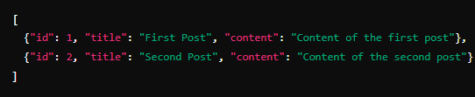
Using RESTful APIs in Django
Steps to Use an API
Identify the API Endpoint
Determine the URL of the API you want to consume
Choose the HTTP Method
Decide whether you need to GET, POST, PUT, DELETE, etc
Send the Request
Use a tool or library to send the HTTP request
Handle the Response
Process the data returned by the API
Example API Endpoint
URL
https://api.example.com/posts
Method
GET
Response

Slide 7
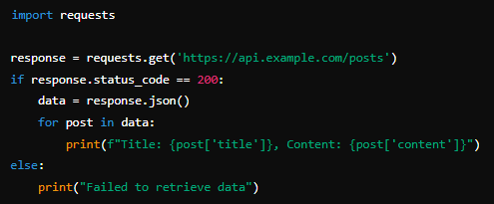
Using Django to Make HTTP Requests
HTTP Libraries
Requests
A popular Python library for making HTTP requests
Installation
pip install requests
Example Code

Slide 8
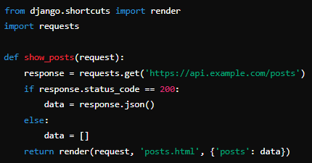
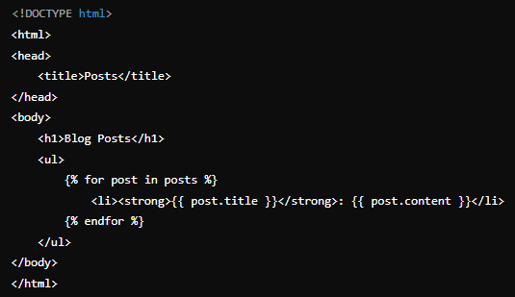
Integrating API Data into Django Views
Example View
Template (posts.html)

Slide 9
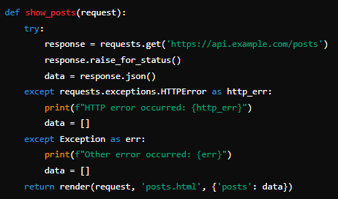
Handling API Errors
Common Error Handling
Check Status Codes
Always check the status code of the response
Log Errors
Log errors for debugging
User Feedback
Provide meaningful feedback to the user
Example Error Handling

Slide 10
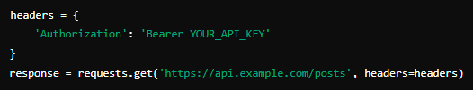
Authentication with APIs
Types of Authentication
API Key
A simple, unique key provided by the API service
OAuth
A more secure and complex authentication method
Token Authentication
Uses a token that must be included in each request
Using API Key

Slide 11

What does REST stand for?
Representational State Transfer
Name two common HTTP methods used in RESTful APIs
GET and POST
What status code is returned for a successful GET request?
200 OK
Which Django library is commonly used to build RESTful APIs?
Django REST Framework (DRF)
How do you install Django REST Framework?
pip install djangorestframework
What is the purpose of the views.py file in a Django app when using DRF?
To define the logic for handling API requests

